Slide 1
Smart Home System: Light and Sound Distance Detector
By Tyler Edwards

Slide 2
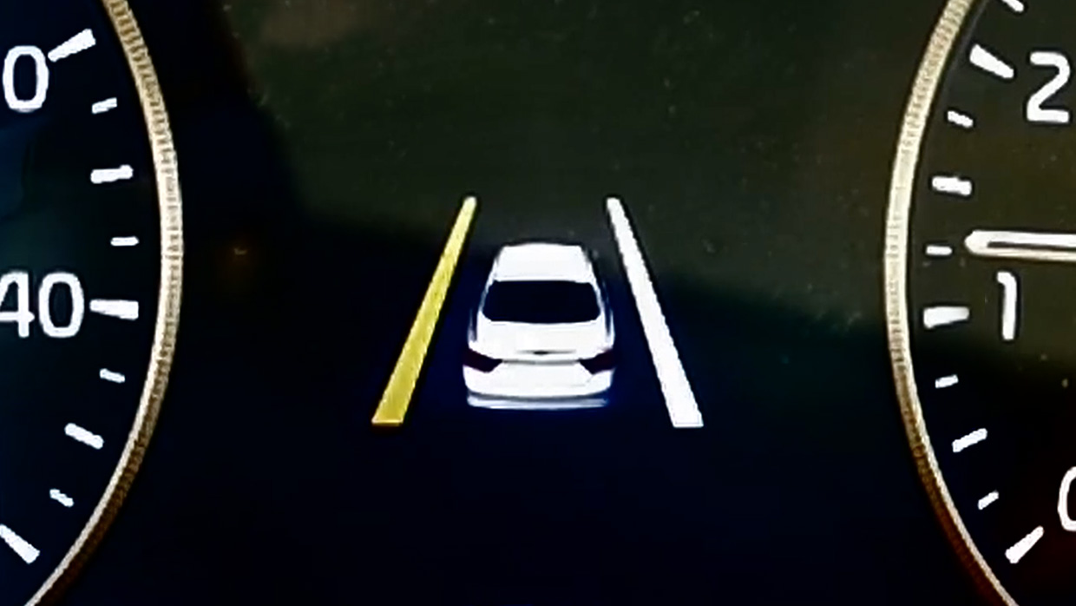
Project Summary
My smart home system circuit will detect the distance between itself and an object and adjust the color of the RGB LED light accordingly. As the object moves closer or farther away, the color of the LED will continue to adjust. When the object reaches a certain distance threshold the circuit will produce a noise to alert the user. This value will be fixed while the circuit is in use, but can be adjusted by the user through a small adjustment to the code. This functionality is similar to a car’s lane assist technology.

Slide 3
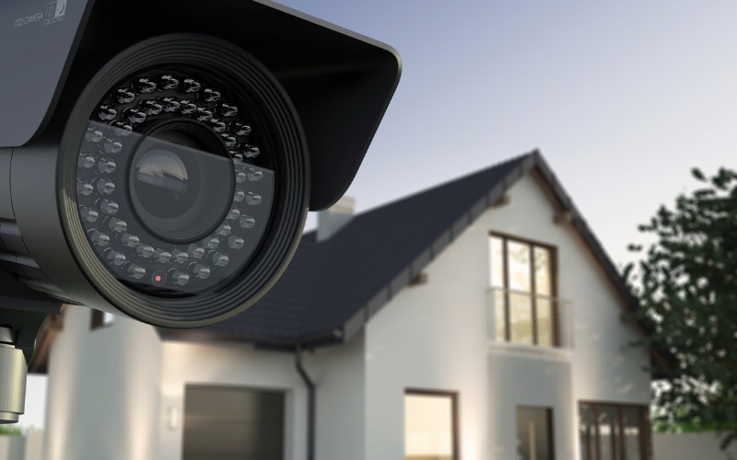
Intended User
Since the my smart home circuit detects objects that are approaching using both visual cues (color of LED light) and audio cues (sound going off) it can be used as a home security system. The intended user of this circuit is a person looking to protect their valuables and home from potential intruders. Not only will the sound and light act as deterrent to the home invader, it will alert the user that someone or something is there.

Slide 4
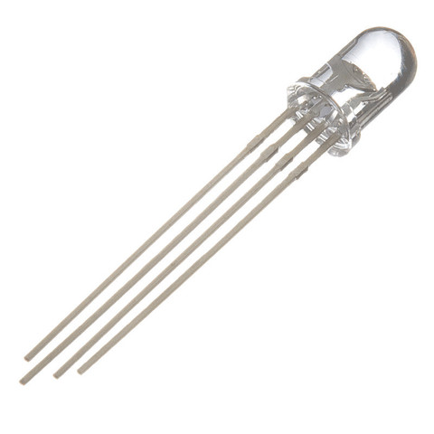
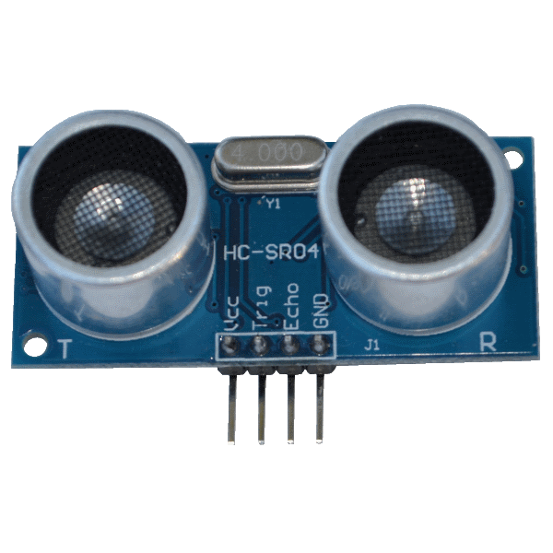
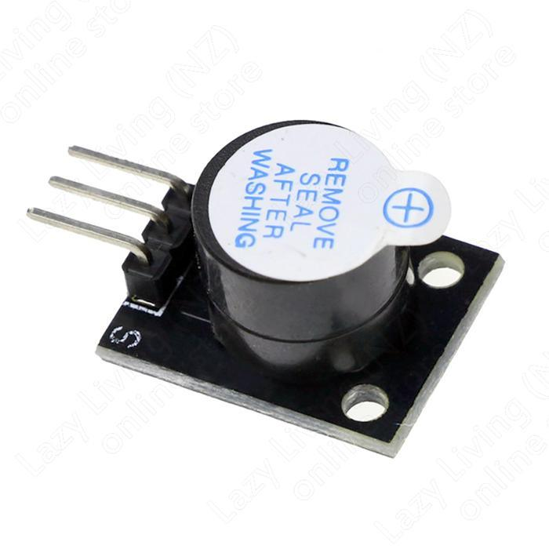
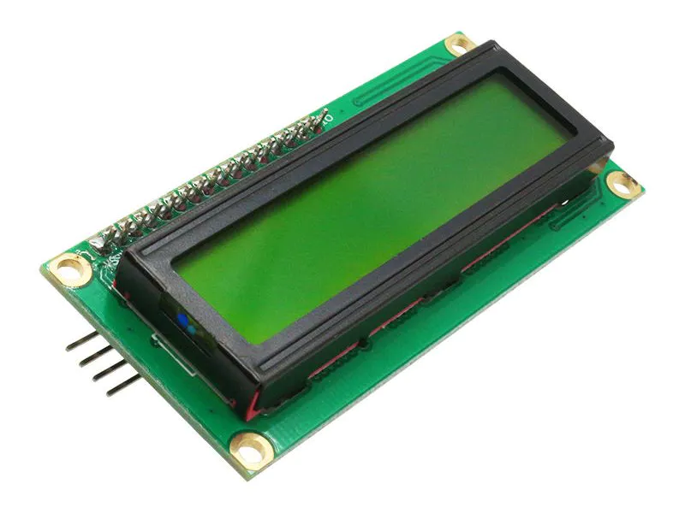
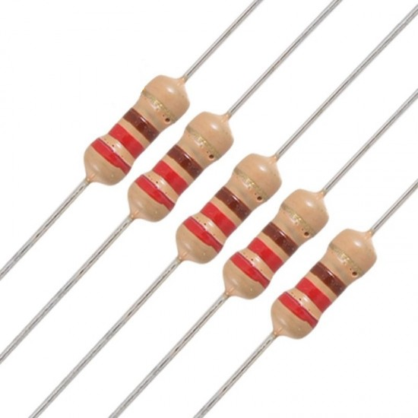
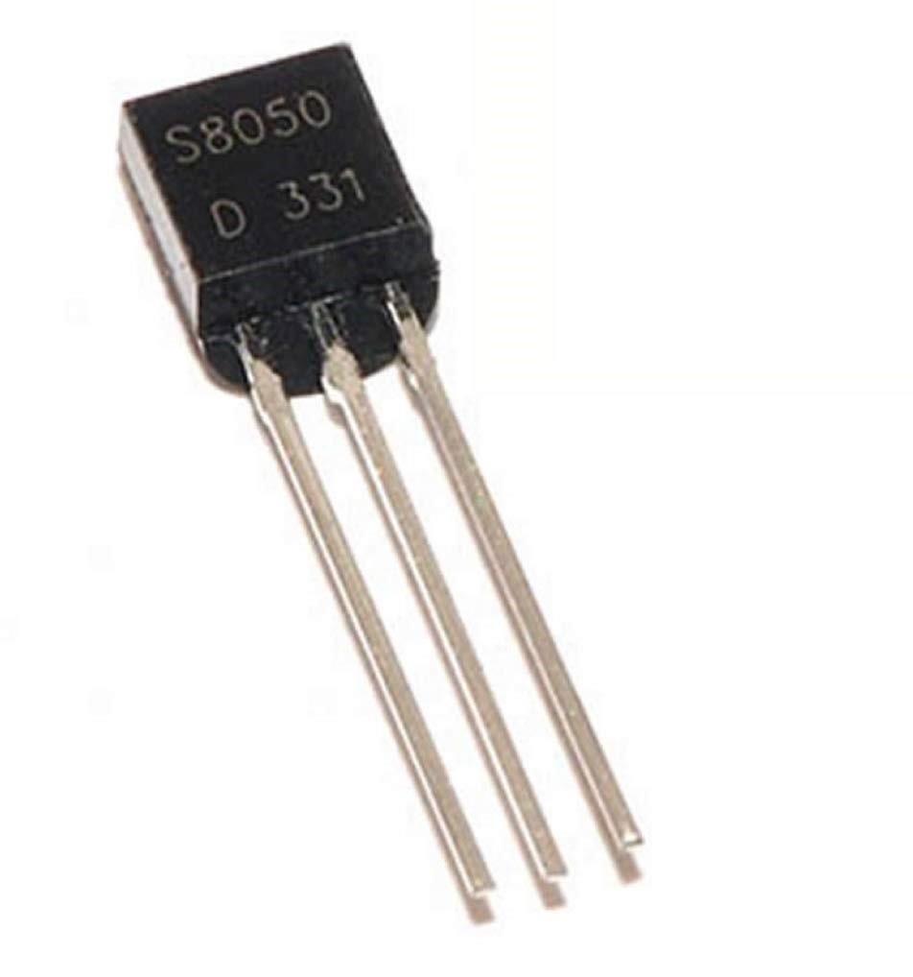
Components Needed
Name | Quantity
RGB LED | 1
Active Buzzer | 1
220 Ω Resistor | 3
NPN Transistor (S8050) | 1
Ultrasonic Sensor | 1
LCD Display | 1
Wires

Slide 5
Project Timeline
 | Dec 1-2 | Dec 3-4 | Dec 5-6 | Dec 7-8 | Dec 9-10 | Dec 11-12
Brainstorm Project
Make Circuit Prototype
Record Showcase Video
Finalize Presentation

Slide 6
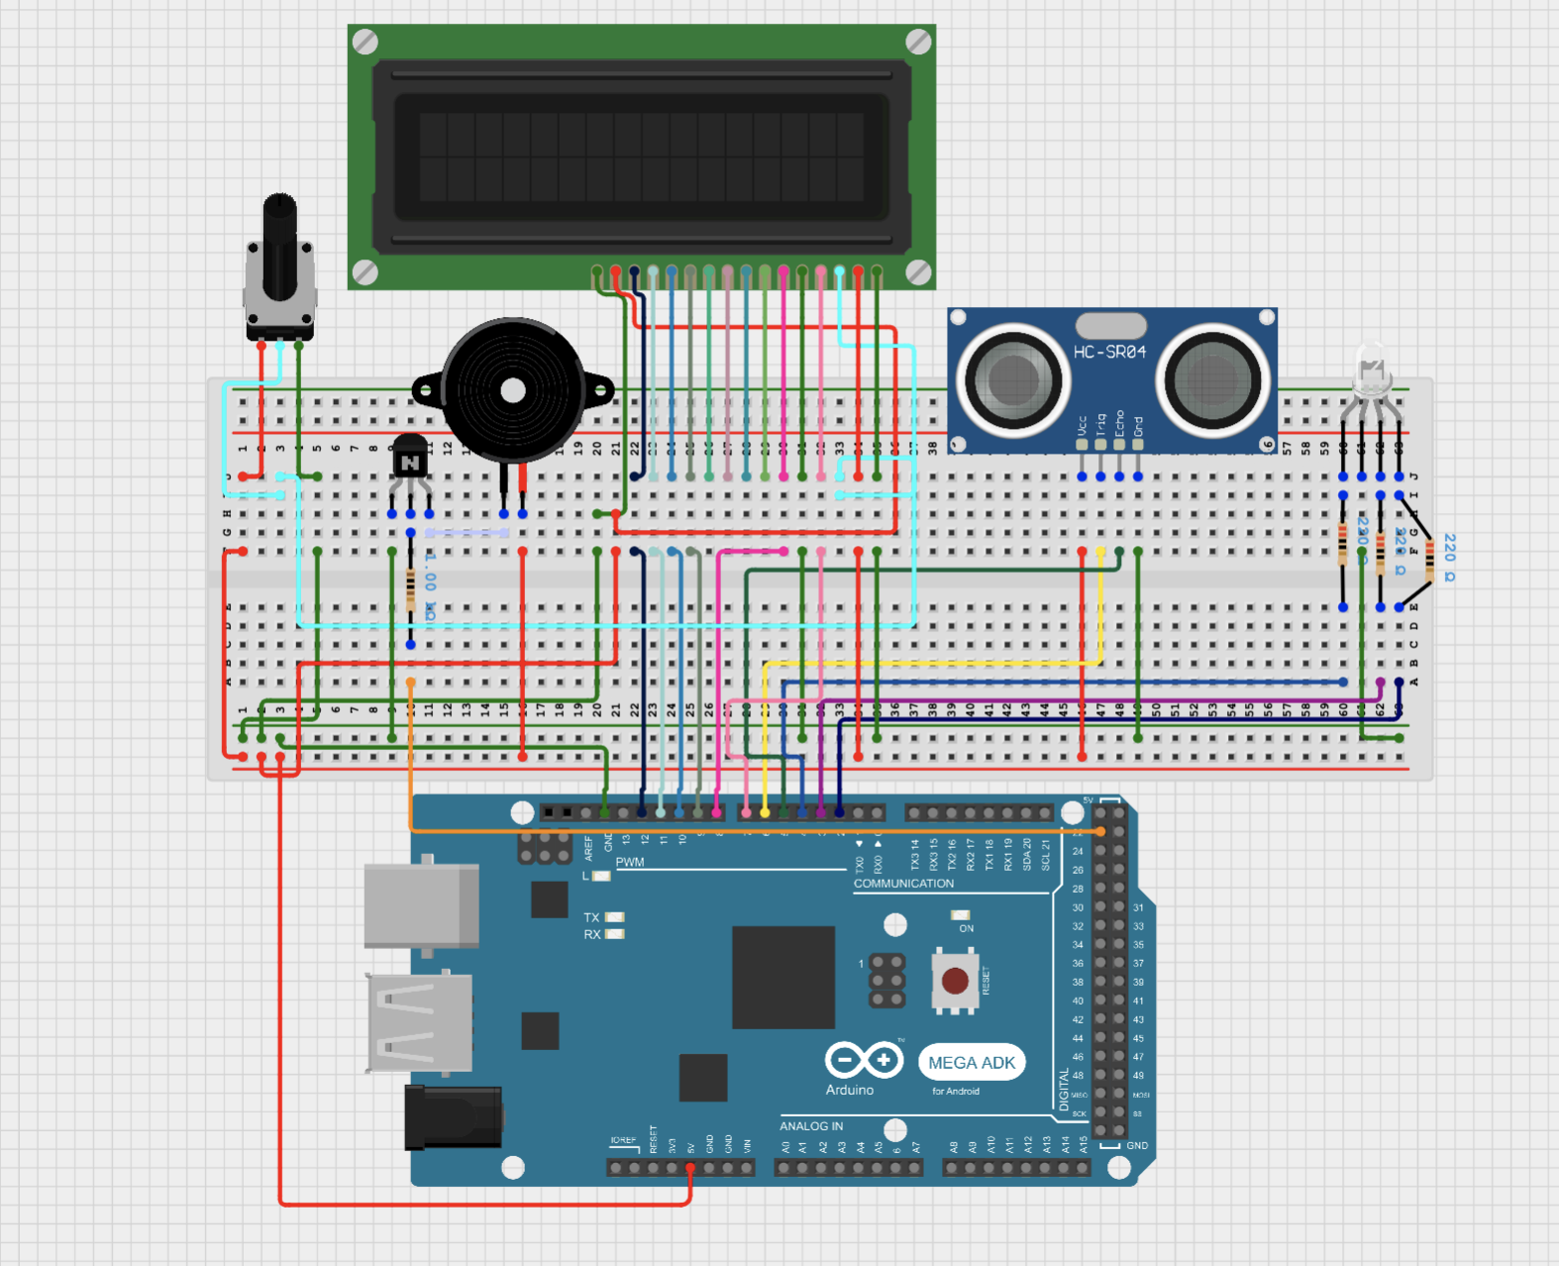
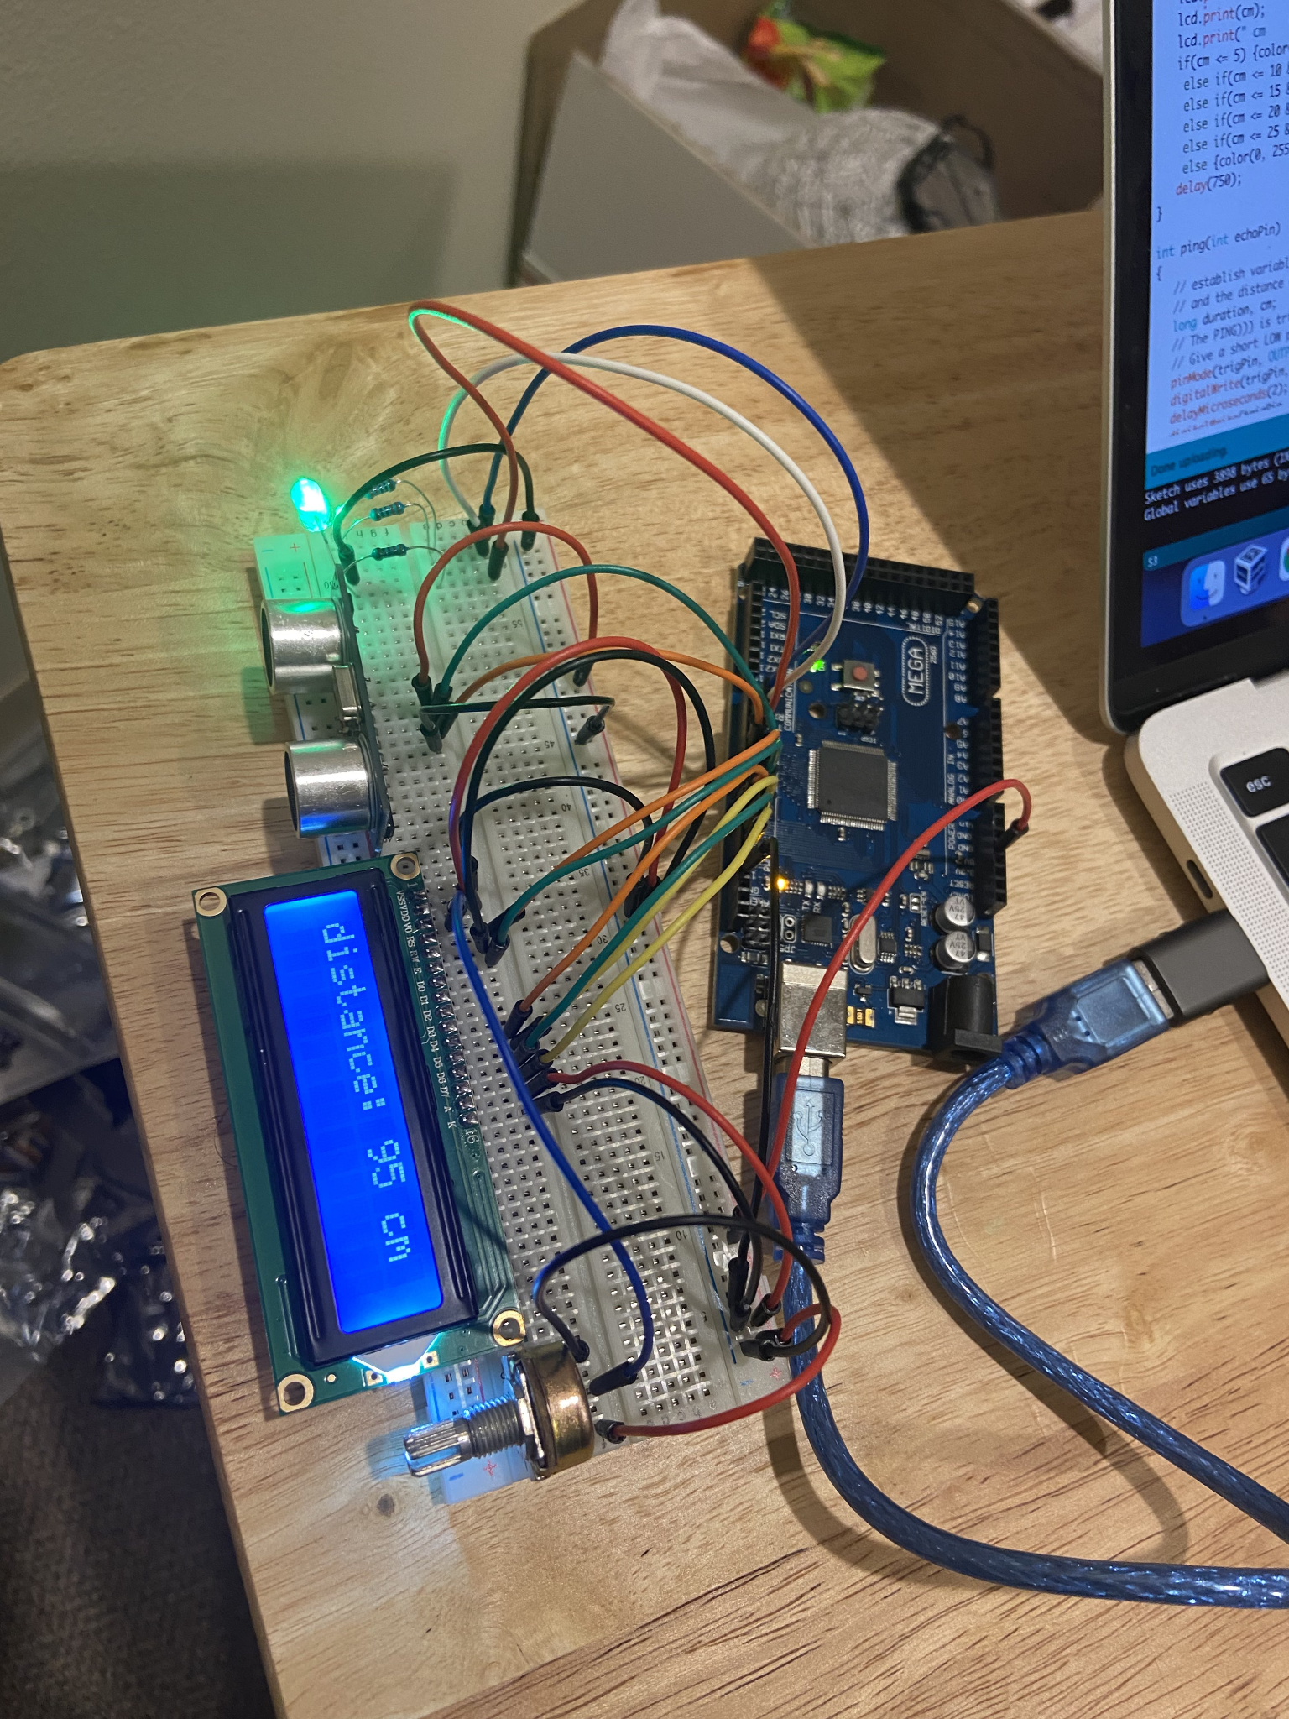
Circuit Diagram

Slide 7
Circuit Interaction - RGB LED
RGB LED
Ultrasonic Distance Sensor
Definition - an LED light that takes in a RGB value and emits a specific colored light accordingly
The RGB LED takes in the distance input from the ultrasonic sensor and converts it into a RGB value that the LED emits.
Definition - a sensor that measures distance by emitting an ultrasound
Distance measured from this sensor is used to adjust the output of other parts of the circuit

Slide 8
Circuit Interaction - LCD Monitor
Ultrasonic Distance Sensor
LCD Display
Definition - a sensor that measures distance by emitting an ultrasound
Distance measured from this sensor is used to adjust the output of other parts of the circuit
Definition - a liquid crystal display that is often used in circuits to display various text
Allows the user to see the distance between the object and the sensor that is being recorded by the ultrasonic sensor

Slide 9
Circuit Interaction - Active Buzzer
Ultrasonic Distance Sensor
Active Buzzer
Definition - a sensor that measures distance by emitting an ultrasound
Distance measured from this sensor is used to adjust the output of other parts of the circuit
Definition - a buzzer that naturally generates sound when it is given power
When a certain distance is recorded by the ultrasonic sensor the active buzzer will begin to generate sound, alerting the user

Slide 10
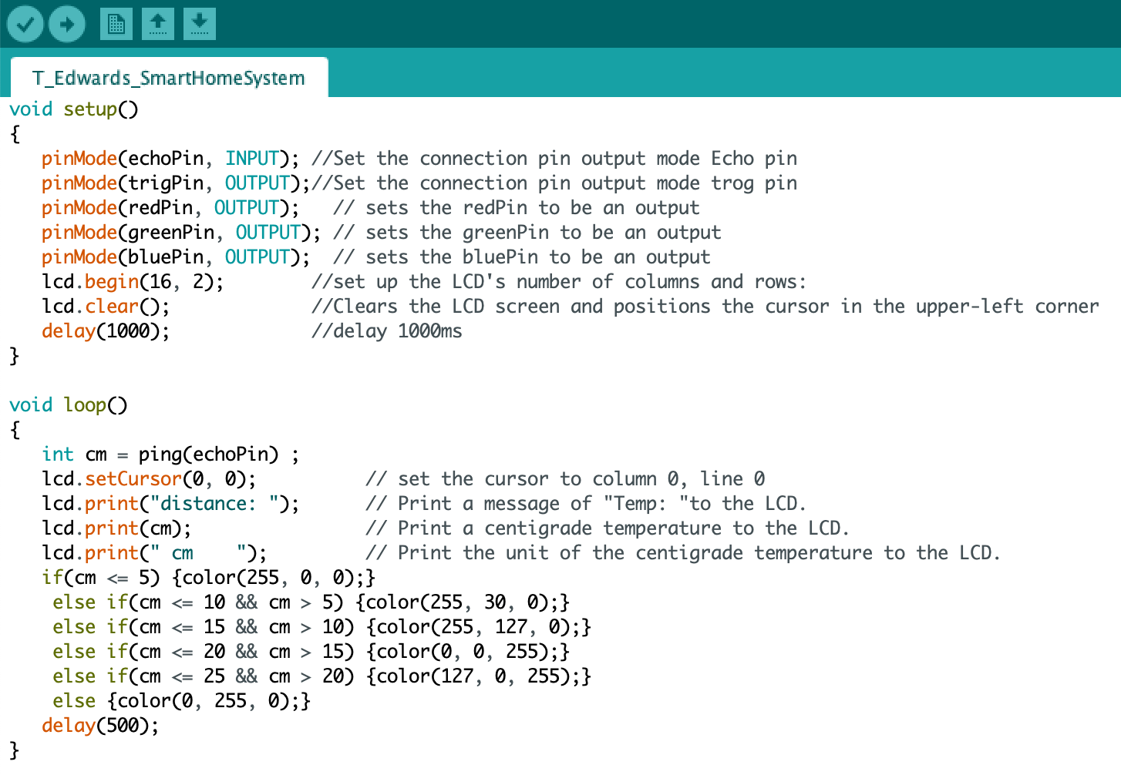
Code Implementation
I decided to write my program in the Arduino IDE, using the base code from an in-class lesson as a jumping point. Since that code already utilizes the LCD display and ultrasonic sensor, from there I added the code for the RGB LED and the Active Buzzer. Using “if” and “else” statements I evaluated the distance received from the ultrasonic sensor and set and RGB value for the LED accordingly.

Slide 11
Circuit in Action

Slide 12
Thank you!

